Slide 1
KeyStone ARM-DSP Interaction
KeyStone Training
Multicore Applications
Literature Number: SPRP###

Slide 2
Agenda
Motivation?
MPM
System printf and dump memory
Memory management
LPAE and non LPAE
Device tree
U-boot
MPM configuration
IPC
Resource management

Slide 3
Typical Keystone II model
MPM – Multi-processor manager

Slide 4
MPM Operation
MPM server daemon maintains a state machine for each slave core
MPM command line (or client) utility provides a command line interface to MPM server. Can be called from a terminal or from an application
MPM can reset a core, load a core with executable, run a core, collect messages from a core, and collect information after core crash (if there is an exception)

Slide 5
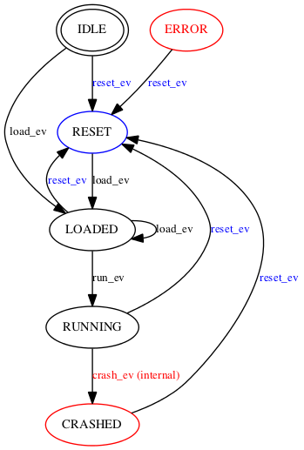
Core state machine

Slide 6
Managing a core
From a terminal
mpmcl load dsp0 program.out
Must be in elf format
Part of the lab exercises
From an application
Include file is part of MCSDK release at /mpm_2_00_01_01/include/mpmclient.h
Library is part of MCSDK release at /mpm_2_00_01_01/lib/libmpmclient.a

Slide 7
DSP Image requirements
DSP image must be in ELF format
MPM must know about the memories that the image uses, and it must not overwrite ARM dedicated memories
More about memory management later
Special sections must be defined to facilitate communications between DSP core and ARM
This is done by the RTSC tools if IPC or MPM used var Resource = xdc.useModule('ti.ipc.remoteproc.Resource');
The next slide shows a project map file with the resource section

Slide 8
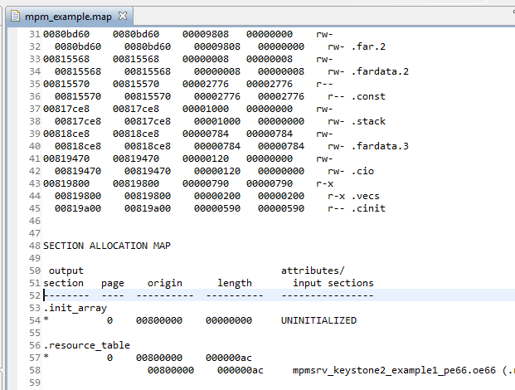
Mpm_example map file

Slide 9
ARM accessing core information
MPM server monitor the resource table section
System_printf writes messages to resource table
The user (or application) can access the messages in /sys/kernel/debug/remoteproc/remoteprocN/trace0
Where N is the DSP core number

Slide 10
ARM accessing core Dump
MPM can monitor crash events from DSP and get core dump
The DSP code needs exception hook
Defined a special memory section
Fault sample test application is part of pdk release at pdk_keystone2_3_00_04_18/packages/ti/instrumentation/fault_mgmt/test

Slide 11
MPM Configuration
The file mpm_config.json is a Java Script Object Notation file that describes the DSP access memory segments to the ARM.
10 memory segments are defined:
Eight segments are for each DSP core l2 local memory
One segment for MSM memory
One segment for the part of DDR that is used by the MPM as shared memory
mpm_config.json definition of Core 0 L2 memory:
{
"name": "local-core0-l2",
"localaddr": "0x00800000",
"globaladdr": "0x10800000",
"length": "0x100000",
"devicename": "/dev/dsp0"
},

Slide 12
MPM Configuration
The two shared memory definitions show that the DSP dedicated memory in DDR starts at 0xa0000000 and has a size of 512M (-1K) bytes
This is TI default
1K of memory is needed for the MPM management
{
"name": "local-msmc",
"globaladdr": "0x0c000000",
"length": "0x600000",
"devicename": "/dev/dspmem"
},
{
"name": "local-ddr",
"globaladdr": "0xa0000000",
"length": "0x1FFFFC00",
"devicename": "/dev/dspmem"
}

Slide 13
Last word about MPM
U-BOOT variable mem_reserve define the DDR area that is used by MPM to load DSP image
More about it later

Slide 14
Managing Keystone II Memories
KeyStone ARM-DSP Interaction

Slide 15
Keystone II shared memories Physical Addresses
For a complete description of possible memory aliasing see the device data manual
DDR3A_REMAP_EN pin determines the mapping of 00 0800 0000 to DDRA or DDRB

Slide 16
Translating Logical memory to physical memory
DSP and all other TeraNet masters – MPAX registers
Static translation (until the MPAX register is changes)
ARM – LPAE
MMU Dynamic translation to 40 bits, can access 8G of DDRA
Controlled by U-boot environment variable mem_lpae=1 (default)
ARM NO LPAE
Disabled MMU, static, can access only 2G of DDRA
Controlled by U-boot environment variable mem_lpae=0

Slide 17
DDRA Size for the ARM
U-boot environment variable ddr3a_size tells the system how much memory is available
0: 2GB (default)
4: 4GB
8: 8GB
Memory is used by Linux Kernel, Linux Users domain and DSP cores. The next slides describe TI partition of the DDRA memory

Slide 18
6638K2K Memory Architecture (8G DDRA)

Slide 19
6638K2K Memory Architecture (2G DDRA –larger DSP memory)

Slide 20
6638K2K Memory Architecture (1G DDRA) (32bit DDR)

Slide 21
Memory Defined in Device Tree
The device tree defines which memory is used by the Linux and which is used by the DSP*
A device tree table is built during boot time (U-BOOT) and updated based on the U-BOOT environment.
The Device Tree for the EVMK2H is tci6638-evm.dts. This tree defines several memories, including the total logical memory and what part of it will be used by the kernel. It also defines what memories will be reserved for the DSP.

Slide 22
Disclaimer
The following slides show how the TI implementation that runs on the TCIEVM6638K2K works.
Other implementations may be different

Slide 23
DDR and MSM Memories
DSP and other masters translate the 32-bit logical address into a 36 (40) bit physical address using MPAX registers.
ARM MMU translates 32-bit logical memory into 40-bit physical memory.
In TI implementation, U-BOOT defines the memory that is available to the MMU.
Starting from device tree and modifies it.
ARM A15 in KeyStone uses large Physical Address Extension mode.
The file board.c (see later) defines the physical memories available for the MMU.

Slide 24
DSP Definition in Device Tree
For each C66x CorePac, seven memory definitions:
Address of Core control registers (boot address, power)
L1 P global memory address
L1 D global memory address
L2 global memory address
In addition, the MSM memory address and DDR addresses that are dedicated to DSP usage are defined.
DSP code that uses DDR must use ONLY the DDR addresses that are assigned to it.

Slide 25
Memory Definitions from 6638K2K Device Tree
memory
{
reg = <0x00000000 0x80000000 0x00000000 0x20000000>;
};
dspmem: dspmem
{
compatible = "linux,rproc-user";
mem = <0x0c000000 0x000600000 0xa0000000 0x20000000>;
label = "dspmem";
};
NOTE: You will see later how the start address of the DSP DDR is determined by the U-BOOT parameters.
When building DSP code, one must be aware what is the start DDR address for DSP

Slide 26
Memory Definitions from 6638K2K Device Tree
dsp7: dsp7
{
compatible = "linux,rproc-user";
reg = <0x0262005C 4
0x02350858 4
0x02350a58 4
0x0262025C 4
0x17e00000 0x00008000
0x17f00000 0x00008000
0x17800000 0x00100000>;
reg-names = "boot-address", "psc-mdstat", "psc-mdctl", "ipcgr", "l1pram", "l1dram", "l2ram";

Slide 27
UBOOT and mem_reserve
Two segments of memory are defined for MMU usage:
The first starts at physical address 0x08 0000 0000 and size of 2G.
The second segment starts at 0x08 8000 0000 and size 6G.
Part of the first segment of memory is reserved for the DSP memory. This is used to load programs and data from the ARM user’s domain to the DSP memory.
The size of the DSP reserve memory is defined in UBOOT as mem_reserve. The default size is 512M – 0x2000 0000.

Slide 28
U-BOOT and mem_reserve
To change the size of the reserve memory, the value mem_reserve should be changed in the UBOOT using setenv mem_reserve value
NOTE: The UBOOT code uses the function ustrtoul to convert the ASCII value into a numeric value. It understands notations such as 512M.
Question: Is changing the mem_reserve value in UBOOT enough to change the memory segment that is dedicated to the DSPs for MPM?
The file mpm_config.json tells MPM what memories are available. It must agree with the device tree and the UBOOT.

Slide 29
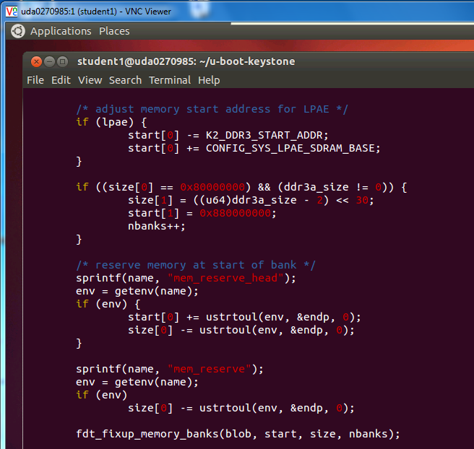
Example code from board.c

Slide 30
Building DSP Code for MPM
DSP projects that use RTSC must define a platform.
The standard TI platform (standard = in the release) was not built to work with MPM if DDR is used by the DSP.
If the DSP code uses only L2 memory, no action is needed. But if the DSP code uses DDR, a new platform must be defined.
Projects that do not use RTSC must have a linker command to define the memory structure. The linker command must be modified to work with MPM.

Slide 31
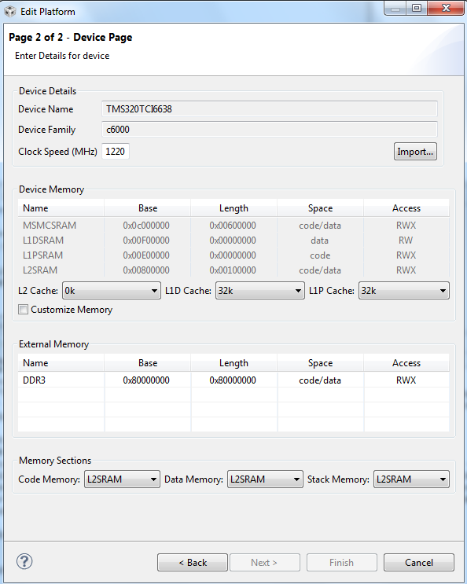
Standard K2H Platform Definition for DSP RTSC Build

Slide 32
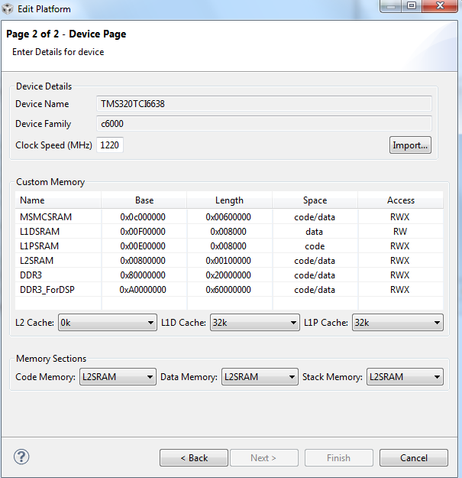
Define New DSP Platform: 2G DDR, 512M Dedicated ARM Memory

Slide 33
Memory Management Summary

Slide 34
Demonstration
Start with the FIR filter program that is part of the DSP optimization Lab.
Runs on one core, two cores, four cores and eight cores
Includes various steps of optimization
Modify for MPM: Change printf to system_printf and so on
Modify the target definition: Partition the DDR into two memories
Rebuild the code without any changes to the linker command
Result: Cannot run the code from MPM
Change the linker to use the memory area dedicated to DSP
Result: The code runs from MPM perfectly

Slide 35
Demonstration Steps
Demonstration steps:
Load the original code into DSP0
Show the map file of the original code
Load the new code into 8 cores
Show the new map file
Reset, load, and run the 8 cores
Look at the results: /debug/remoteproc/remoteprocN/trace0

Slide 36
Managing Peripherals and IP in a Heterogeneous Device
KeyStone ARM-DSP Interaction

Slide 37
Challenges
How to use peripherals and other IP in ARM and DSP KeyStone devices?
Configuration
Run-time usage
Solution: Chip Support Library (CSL) and Low-Level Drivers (LLD) on DSP, LINUX drivers on the ARM
How to share resource configuration, control, and usage between different cores?
Protect resources from conflict usage
ARM runs Linux, C66x runs BIOS
Solution: Resource Management

Slide 38
DSP View of Peripherals and IP
Chip support Library (CSL) provides access to the peripherals and other IP
CSL translates physical MMR locations into symbols, and provides functions to manipulate the MMR
Low level drivers (LLD) is an abstraction layer that simplified the usage of peripherals
Some peripherals have high layer libraries (on the top of LLD) to further abstract peripherals usage details from the application

Slide 39
DSP: Interface via LLD and CSL Layers

Slide 40
LLD Overview
Low Level Drivers (LLD) hide the details of CSL from the application.
Simple IP and peripherals do not have LLD. The application uses CSL directly.
Most of the IPs use LLD.
Linux drivers are used from the ARM side.

Slide 41
Linux Control Peripherals and IP
MMU controls memory access for user mode in Linux. Applications do not see physical addresses.
Device drivers can be called by the applications. They can access physical memory.
Linux Device Drivers provide:
Modularity
Standard interface
Standard structure

Slide 42
What are Linux Device Drivers?
Link between standard interface and the hardware
Hide the complexity of device operation from the user
Provide standard API to use the device
Map the API to one or more functions that manipulate the specific hardware device.
Linux kernel modularity scheme enables new device drivers to be easily added to the kernel.

Slide 43
Linux Application API
Device drivers can be loaded during boot time or loaded (as modules) during run time.
Driver classification:
Character device
Block device
Network interface
Each driver type has standard API. For example, character devices will have open and close as well as read and write functions.

Slide 44
KeyStone Drivers Structure Example - SRIO

Slide 45
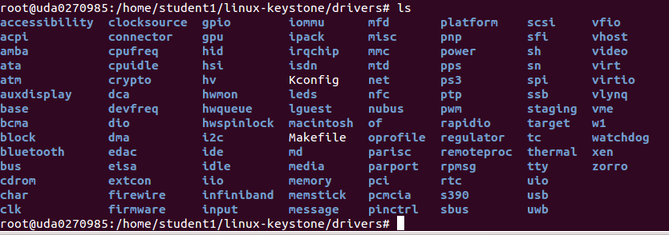
Linux Drivers
linux-keystone/drivers (cloned from the public git)

Slide 46
Linux Device Tree
KeyStone ARM-DSP Interaction

Slide 47
Linux Device Tree
How do Linux drivers know what resources are available and what are the physical attributes of the resources?
The Device Tree
Linux Device tree is an ASCII file XX.dts that describes the resources available to Linux. A compiled version of the file XX.dtb is used by the Linux system.
Device tree source code has a well-defined syntax

Slide 48
Standard Device Tree Example
k2hk-evm.dts is from the public git server
/dts-v1/;
/include/ "skeleton.dtsi“
/ { model = "Texas Instruments Keystone 2 SoC“
; compatible = "ti,tci6638-evm“
; #address-cells = <2>;
#size-cells = <2>;
interrupt-parent = <&gic>;
aliases {
serial0 = &uart0; gpio0 = &gpio0;
ethernet1 = &interface1;
};
chosen { };

Slide 49
Device Tree Defines Available CPU
cpus
{ interrupt-parent = <&gic>;
cpu@0 {
compatible = "arm,cortex-a15";
};
cpu@1 {
compatible = "arm,cortex-a15";
};
cpu@2 {
compatible = "arm,cortex-a15";
};
cpu@3 {
compatible = "arm,cortex-a15";
};
};

Slide 50
Device Tree Defines Available Clocks
chipclk12: chipclk12 {
#clock-cells = <0>;
compatible = "fixed-clock-factor";
clocks = <&chipclk1>;
mult = <1>;
div = <2>;
};

Slide 51
Device Tree Defines Available Interrupts
ipcirq0: ipcirq0@26202bc
{ /* ipc irq chip */
compatible = "ti,keystone-ipc-irq";
reg = <0x026202a0 4 /* host ack register */
0x02620260 4>; /* ipc host interrupt generation register */
interrupts = <0 4 0x101>;/* it should match the value in irqs.h */
/* following is the source id to irq mapping SRCS0 <-> ipc hw irq 0 ... SRCS27 <-> ipc hw irq 27 note that SRCS0 is bit 4 in ipc register */
interrupt-controller;
#interrupt-cells = <2>;
};

Slide 52
Device Tree Defines Interrupt Queues
queues {
qpend-arm-low {
values = <652 20>;
interrupts = <0 40 0xf04 0 41 0xf04 0 42 0xf04 0 43 0xf04 0 44 0xf04 0 45 0xf04 0 46 0xf04 0 47 0xf04>;
reserved;
};
qpend-arm-hi {
values = <8704 32>;

Slide 53
Device Tree Defines Linux Regions
regions {
#address-cells = <1>;
#size-cells = <1>
; ranges;
region-12 {
id = <12>;
values = <2048 128>; /* num_desc desc_size */
link-index = <0x4000>;
};

Slide 54
Device Tree Defines Linux Communications Channels
channels {
nettx0
{ transmit;
label = "nettx0";
pool = "pool-net";
submit-queue = <648>;
/* complete-queue = <xx>;
*/ /* debug;
*/ /* channel = <0>;
*/ /* priority = <1>;
*/ };

Slide 55
ARM-DSP Resource Management
When ARM and DSP co-exist, some resources are managed by the resource manager server.
Memories are managed differently. The next two sections describes how memory is managed in a DSP-ARM SoC.

Slide 56
Resource Management
KeyStone ARM-DSP Interaction

Slide 57
Keystone II RM: Major Requirements
Dynamically manage resources
Enable management of resources at all levels within system software architecture
Core, task, application component (LLD)
During initialization and during run time, from any thread
Runtime modification of resource permissions.
Automate reservation of resources taken by Linux kernel
Use generic, processor-independent transport interface that allows RM instances to communicate regardless of device hardware architecture
Transport glue logic provided by application
Easy to port RM to new devices

Slide 58
Keystone II RM – Overview (1)
Instance-based Client/Server Architecture:
Three instance hierarchy:
RM Server – Global management of resources and permission policies
RM Client – Provide resource services to system software elements
RM Client Delegate (CD)
Offloads management of resource subsets from Server
Manages a sub-pool of resources
Resource services provided via instance service API
RM Instances Communication Over Generic Transport Interface
Application must setup data paths between RM instances
Allows RM to run on any device architecture without modification to RM source

Slide 59
Keystone II RM – Overview (2)
RM server is a Linux process.
Two files define the behavior of the RM; The global resource list and the policy file.
Both files are written in the same syntax as device tree and are compiled the same way.

Slide 60
Keystone II RM – Overview (3)
Global Resource List (GRL)
GRL captures all resources that will be tracked for a given device
Facilitates automatic extraction of resources used by ARM Linux from Linux DTB
Policies specify RM instance resource privileges
Resource initialization, usage, and exclusive right privileges assigned to RM instances
Runtime modification of policy privileges
APIs and Linux CLI (Planned)
Resources stored within balanced search tree allocators
Reduce memory usage and resource lookup times
Allocators facilitated by NameServer

Slide 61
Keystone II RM: Overview
ARM/DSP n
ARM/DSP n+1
User Mode (ARM)
Resource Policies
Global Resource List (GRL)
Linux DTB
Available resources are inverse of Linux DTB
Memory Allocator
QMSS
CPPI
RM Server Instance
RM CD Instance
QMSS
Allocation policies
Resource Allocators
PA
Resources Allocated from Server
CD Service Transaction Handler
CPPI
CD Service Transaction Handler
Service
Port
Etc
Transport API
PA
Service
Port
ARM ⬄ DSP Transport
DSP ⬄ DSP Transport
Etc
Transport API
Transport-Specific Data Path
ARM ⬄ DSP Transport
ARM/DSP n+2
DSP ⬄ DSP Transport
ARM/DSP n+3
QMSS
QMSS
DSP ⬄ DSP Transport
RM Client Instance
Transport API
RM Client Instance
CPPI
CPPI
Transport API
Client Service Transaction Handler
Client Service Transaction Handler
PA
PA
Mem Alloc
Service
Port
Mem Alloc
Service
Port
Etc
Etc

Slide 62
Keystone II RM: Instance Topology Example
DSP Multicore Application
IPC
BIOS
Linux User-Space
LLD
Etc
LLD
Etc
LLD
Etc
RM Server
RM Client Delegate
RM Client
ARM
DSP 1
DSP 2

Slide 63
Keystone II RM: Services
RM Services:
Allocate (initialization, usage)
Free
Map resource(s) to NameServer name
Get resource(s) tied to existing NameServer name
Unmap resource(s) from existing NameServer name
Non-blocking service requests directly return result
Blocking service requests return ID to system

Slide 64
Keystone II RM: Global Resource List (GRL)
Specified in Device Tree Source (DTS) format
Open source, dual GPL/BSD-licensed LIBFDT used for parsing GRL
Input to server on initialization
Server instantiates allocator for each resource specified in GRL
A GRL specification for a resource includes:
Resource name
Resource range (base + length)
Linux DTB alias path (if applicable)
Resource NameServer assignments (if applicable)
Permissions not specified in GRL; In the policies

Slide 65
GRL Example
An example of the Global Resource List and policy files can be found in the MCSDK:
/MCSDK_3_00_00_XX/pdk_keystone2_1_00_00_XX/packages/ti/drv/rm/device/k2h
The first few lines of the file are shown in next slide.
In the same directory there are two policy files:
policy_dsp_arm.dts
policy_dsp-only.dts

Slide 66
global-resource-list-arm-dsp.dts
/dts-v1/;
/ {
/* Device resource definitions based on current supported QMSS, CPPI, and
* PA LLD resources */
qmss {
/* Number of descriptors inserted by ARM */
ns-assignment = "ARM_Descriptors", <0 4096>;
/* QMSS in joint mode affects only -qm1 resource */
control-qm1 {
resource-range = <0 1>;
};
control-qm2 {
resource-range = <0 1>;
};
/* QMSS in joint mode affects only -qm1 resource */
linkram-control-qm1 {
resource-range = <0 1>;
};

Slide 67
Policy Example: policy_dsp_arm.dts (1)
/dts-v1/;
/* Keystone II policy containing reserving resources used by Linux Kernel */
/ {
/* Valid instance list contains instance names used within TI example projects
* utilizing RM. The list can be modified as needed by applications integrating
* RM. For an RM instance to be given permissions the name used to initialize it
* must be present in this list */
valid-instances = "RM_Server",
"RM_Client0",
"RM_Client1",
"RM_Client2",
"RM_Client3",
"RM_Client4",
"RM_Client5",
"RM_Client6",
"RM_Client7";

Slide 68
Policy Example: policy_dsp_arm.dts (2)
qmss {
control-qm1 {
assignments = <0 1>, "iu = (*)";
};
control-qm2 {
assignments = <0 1>, "iu = (*)";
};
linkram-control-qm1 {
assignments = <0 1>, "(*)"; /* Used by Kernel */
};
linkram-control-qm2 {
assignments = <0 1>, "(*)"; /* Used by Kernel */
};
linkram-qm1 {
assignments = <0x00000000 0xFFFFFFFF>, "iu = (*)";
};
linkram-qm2 {

Slide 69
ARM-DSP Communication Architecture
KeyStone ARM-DSP Interaction

Slide 70
ARM-DSP Collaboration
MPM: Managing the DSP cores from the ARM
DSP executables are in the ARM file system
ARM can reset, load, run, and get messages and dump core out of a DSP core
IPC: Exchanging data and messages between ARM and DSP
User Space libraries: IPC v3, MsgCom, PktIO
Applications that use IPC – OpenCL, openMP
Sockets
openEM

Slide 71
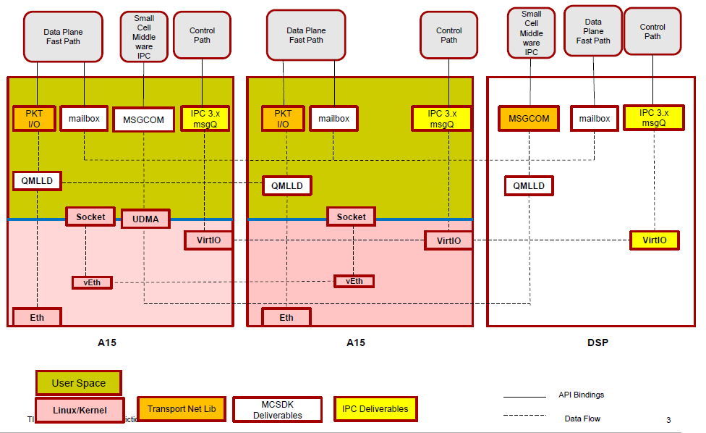
IPC Technologies in KeyStone II

Slide 72
IPC Libraries MCSDK release 3_15

Slide 73
IPC Types: IPCv3
Control Path: IPCv3
Standard APIs agree with older versions of IPC
General purpose control path supports reliable delivery
Designed to deliver short messages, but can be used for “unlimited” data movement
Uses RPMSG kernel driver for clean partition between user and kernel space, Thus slower than data path

Slide 74
IPC Types: Fast Path
Fast Path: PktIO and QMSS
On the ARM side, it provides a library netapi that supports creating, sending, and receiving packets from the ARM user space.
Fire and forget (send) polling (ARM) for receive. On DSP, receive is polling, or interrupt, or accumulators (using QMSS DLL)
Navigator-based transaction, sending packets (descriptors)
Low latency, high throughput

Slide 75
IPC Types: MsgCom
MsgCom: QMSS-based library (User Space)
Supports zero copy or PktDMA copy of descriptors
Supports a wide set of communication features (blocking, non-blocking, interrupt, polling)
Depends on several other component such as receive agent and job scheduler

Slide 76
ARM IPC Support
Remote Processor Messaging (RPMsg) is an open-source friendly Inter Processor Communication (IPC) framework
SysLink (Part of the IPC release) is a runtime library that provides software connectivity between multiple processors. Each processor may run either an HLOS (such as Linux, QNX, etc.) or an RTOS (such as SYS/BIOS).

Slide 77
IPC Examples
MCSDK release has several examples that show IPC properties
Instructions how to install IPC and build these examples on the Linux side and the DSP side are given in the release.
The out-of-box example is described in the next few slides.

Slide 78
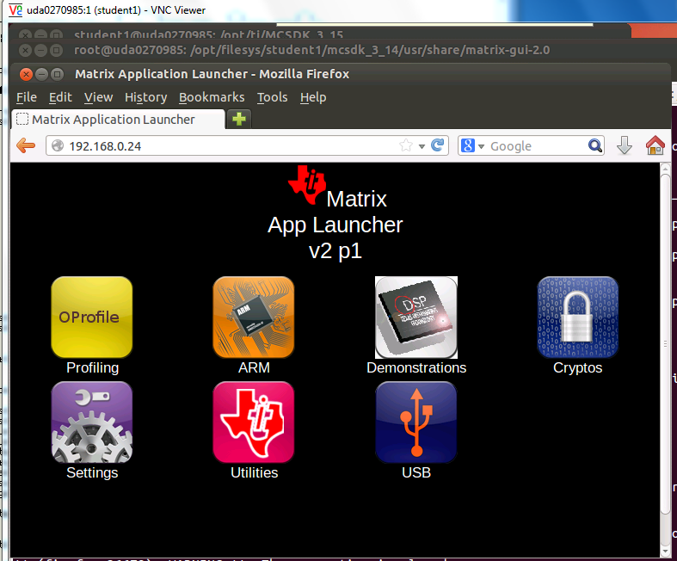

Slide 79
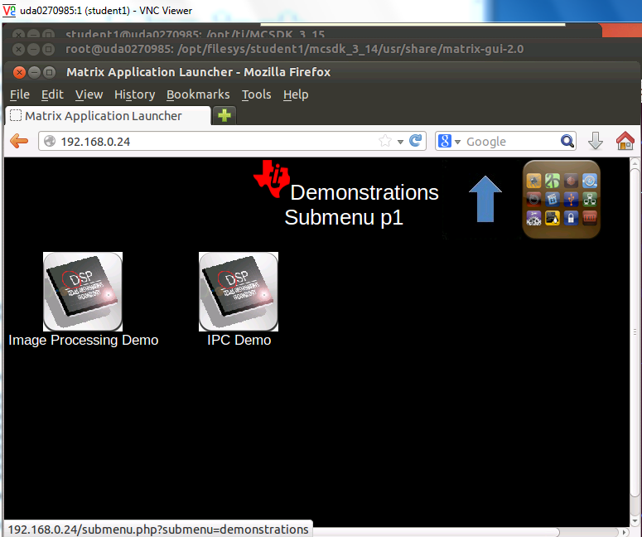

Slide 80
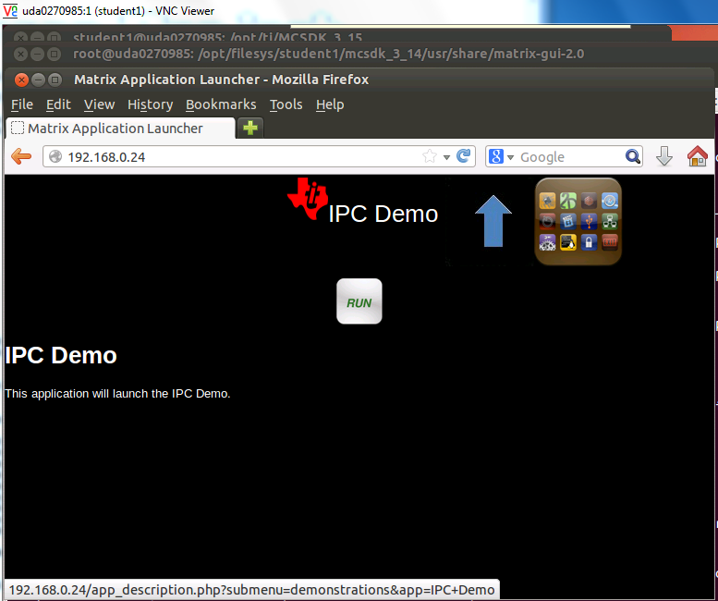

Slide 81
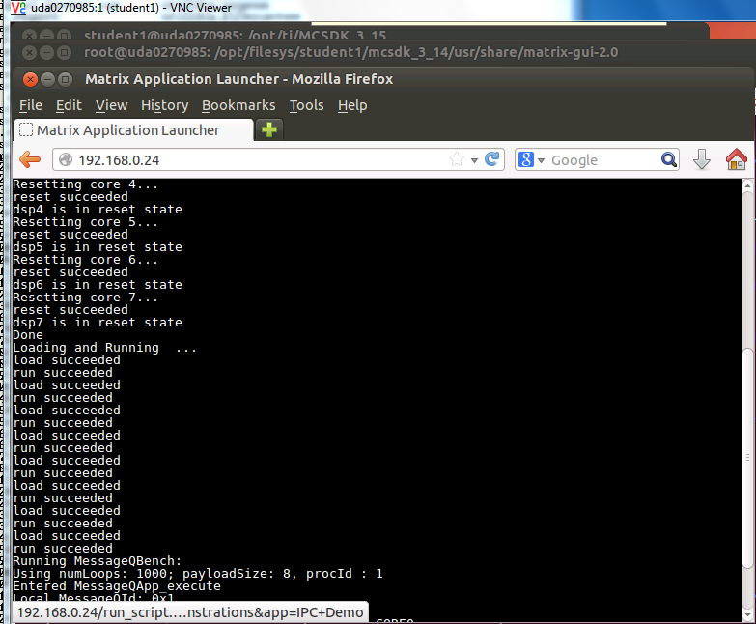

Slide 82
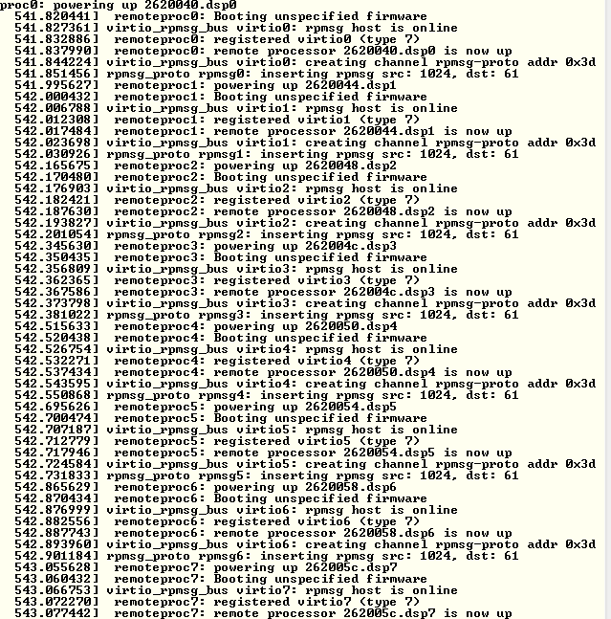

Slide 83
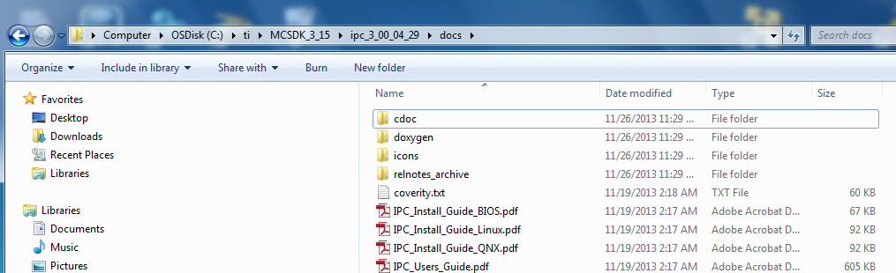
Release IPC Examples

Slide 84
RPMsg
The following are the main features provided by the RPMsg framework:
Device Management: Complete life-cycle management of the remote processor cores including the following specific functionalities
Device Initialization - Programming and loading an executable, memory management and powering up the processor
Power Management - Runtime power management of the remote processors, putting them into lowest power state (suspend) when not being used actively
Tracing - Provide trace logging of code running on remote processors
Exception Management - Provide information regarding a remote processor fatal errors or exceptions
Error Recovery - Reload and reboot the remote processors upon any fatal error or exception
Messaging Framework: A generic Linux messaging architecture/framework with the ability to exchange fixed size control messages with remote processors
Resource Management: Request and release peripherals/hardware accelerators for usage by the remote processors, and putting constraints like bandwidth, frequency and latency to meet specific application performance and power requirements

Slide 85
For More Information
Software downloads and device-specific Data Manuals for the KeyStone II SoCs can be found at TI.com/multicore.
For articles related to multicore software and tools, refer to the Embedded Processors Wiki for the KeyStone Device Architecture.
For questions regarding topics covered in this training, visit the support forums at the TI E2E Community website.

Slide 86
Backup – PktLib Utility Libraries

Slide 87
Packet Library (PktLib)
Purpose: High-level library to allocate packets and manipulate packets used by different types of channels.
Enhance capabilities of packet manipulation
Enhance Heap manipulation

Slide 88
Heap Allocation
Heap creation supports shared heaps and private heaps.
Heap is identified by name. It contains Data buffer Packets or Zero Buffer Packets
Heap size is determined by application.
Typical pktlib functions:
Pktlib_createHeap
Pktlib_findHeapbyName
Pktlib_allocPacket

Slide 89
Packet Manipulations
Merge multiple packets into one (linked) packet
Clone packet
Split Packet into multiple packets
Typical pktlib functions:
Pktlib_packetMerge
Pktlib_clonePacket
Pktlib_splitPacket

Slide 90
PktLib: Additional Features
Clean up and garbage collection (especially for clone packets and split packets)
Heap statistics
Cache coherency

Slide 91
ARM-DSP Necessities

Slide 92
Msgrouter
Creates special msgcom channels known as “control channels” or “control path”
Control channel used for system messages and synchronization purposes
Agent module (later slide) runs consistently while waiting for messages on these control channels
“ARM created a new data channel, let’s let the DSP know by sending a message over the control path”

Slide 93
Job Scheduler (JOSH)
Allows function call made on one processing element to be executed on another processing element
Defines a prototype for a job/function call
For DSP to understand what ARM is saying (or vice versa), “execute this particular function on DSP”
Must have common message type
User application does not directly exercise any of the JOSH APIs

Slide 94
Agent
Module which implements remote procedure calls between the ARM and the DSP
Main purpose is to sync resources between ARM and DSP
Utilizes msgcom control path to sync updates about resources – creation, deletion, modification
Must have separate instance of Agent for each DSP core being used.

Slide 95
DSP Agent Creation
Agent has to be initialized on DSP before any remote function calls made
Agent initialization requires a shared memory address in DDR3
Must reserve 4096 bytes of memory in DSP linker
Next, Agent must be created
Finally the Agent must be synced

Slide 96
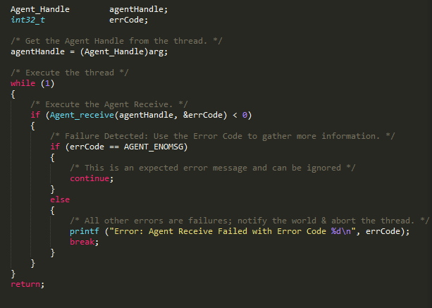
Agent Receive
The Agent receive API has to be called on both ARM and DSP to receive remote function call requests

Slide 97
For More Information
Software downloads and device-specific Data Manuals for the KeyStone SoCs can be found at TI.com/multicore.
Multicore articles, tools, and software are available at Embedded Processors Wiki for the KeyStone Device Architecture.
View the complete C66x Multicore SOC Online Training for KeyStone Devices, including details on the individual modules.
For questions regarding topics covered in this training, visit the support forums at the TI E2E Community website.

